Slide 1
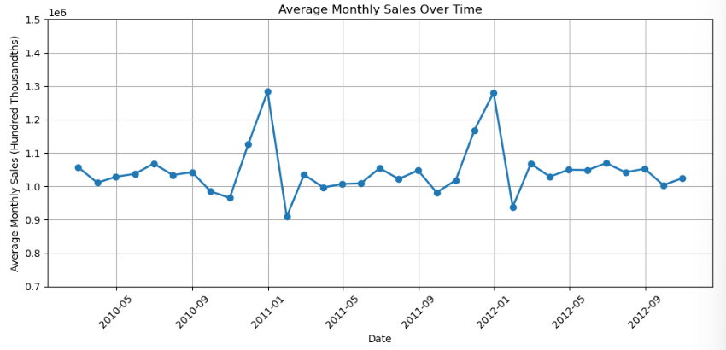
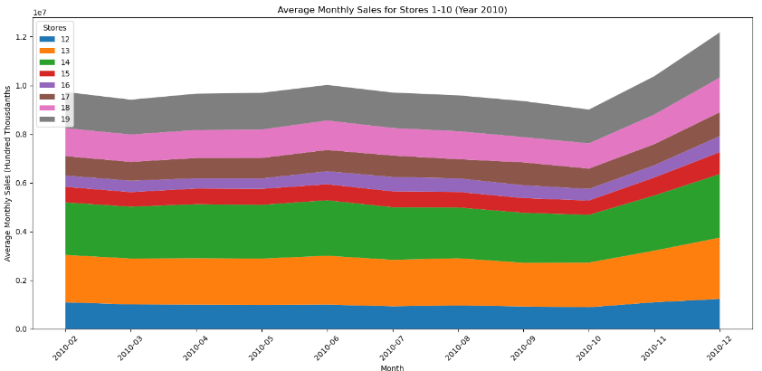
Walmart Monthly Sales
Averages across all stores show an increase in sales during holiday months (Labor Day, Thanksgiving, Christmas) across multiple years, the average across the 45 stores being 1.3 million in sales for the month of December in 2010 and 2011.
Individual stores show consistency in sales in monthly averages this may be due to location.
Source: Kaggle, Walmart Sales. Walmart Sales Dataset of 45 stores (kaggle.com)

